Slide 1
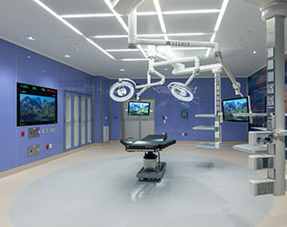
Post-Operative Cognitive Decline (POCD) Risk Prediction Using Machine Learning
-Vineeth Karjala
-Uttam Kumar Bellamkonda

Slide 2
Introduction
Some patients, especially older adults, may face memory and thinking problems after surgery. This condition is called POCD, and it can affect their ability to focus, remember things, or solve problems during recovery.
When POCD occurs, patients often recover more slowly, need more support, and may have to stay longer in the hospital or go to rehabilitation before returning home.
By using machine learning models trained on patient data, doctors can get an early warning about who is at high risk and provide better care.

Slide 3
Literature Review
POCD affects up to 10–60% of older adults after major surgery, especially those requiring ICU care.
Risk factors include advanced age, longer surgeries, ICU stay, comorbidities, hypotension, and anesthesia exposure.
Recent studies highlight the need for early prediction to support clinical decision-making.
Machine learning has shown promise in detecting high-risk postoperative patients using EHR data.

Slide 4

Problem Statement
POCD is quite common, but it often goes undiagnosed or recognized late because there is no automatic clinical tool that can predict which patients are at higher risk after surgery.
In most cases, doctors only identify POCD after symptoms start, such as confusion or memory issues — and by then, treatment and recovery become more challenging.
By using hospital data and machine learning models, we aim to predict POCD in advance, helping doctors provide early monitoring and support to improve patient outcomes.

Slide 5
Project Goals
Build a machine learning model that uses hospital records and surgery details to identify patients who may have a higher risk of developing POCD.
Provide doctors with an early warning, so they can monitor high-risk patients more closely and support their cognitive recovery.
Create a system that can improve safety and recovery, especially for older adults, and can be developed into a real clinical decision support tool in the future.

Slide 6

Dataset
We used the MIMIC-IV v3.1 dataset from PhysioNet, which includes structured data such as patient demographics, surgery details, ICU stays, and diagnosis codes. Since this dataset does not include free-text clinical notes, we could not apply direct NLP methods.
A separate resource, MIMIC-IV-Note, provides anonymized clinical notes for the same patients. In the future, combining both datasets can help build multimodal machine learning models and apply advanced NLP tools like ClinicalBERT to better detect cognitive changes.
During preprocessing, we found duplicate entries and imbalance issues where most outcomes were labeled as no-POCD. After cleaning we obtained a balanced dataset suitable for building reliable models.
Dataset link : https://physionet.org/content/mimiciv/3.1/
We specifically focused on surgical ICU patients because this group has a significantly higher risk of developing POCD, making early prediction clinically impactful.

Slide 7
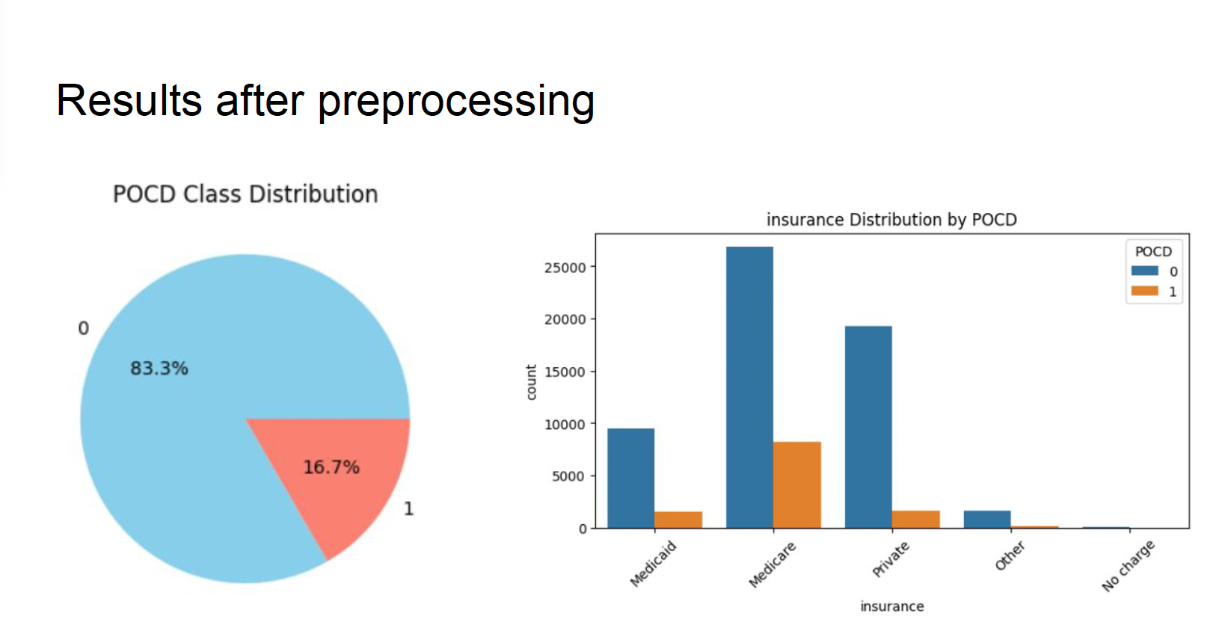
Data Processing Steps
We combined important hospital records such as demographics, surgeries, ICU stays, and diagnosis codes, and kept only patients who underwent a surgery to focus on the POCD-risk group. We also created useful features like age, number of procedures, ICU transfers, and ICU stay duration, while handling missing values to maintain complete data.
To ensure correct labeling, we removed duplicate entries and used ICD diagnosis codes to identify POCD and non-POCD patients accurately.
Then split the data into training, validation, and testing sets using stratified sampling to keep class proportions consistent.

Slide 8
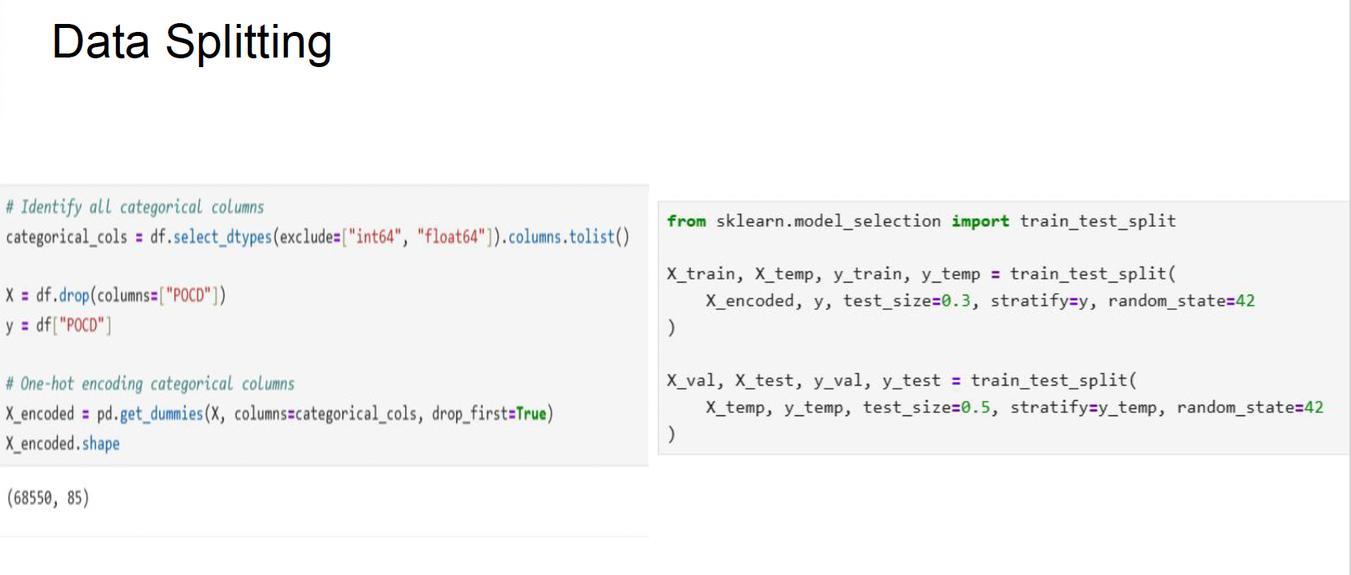
Data Splitting
To build a reliable model, we divided the dataset into three parts: 60% for training, where the model learns patterns from the data.
20% of the data was used for validation, helping us adjust model parameters and improve performance during development.
The remaining 20% was kept aside for final testing, so we could evaluate how well the model works on completely unseen data. We used stratified sampling to keep the proportion of POCD and non-POCD patients consistent across all splits.

Slide 9
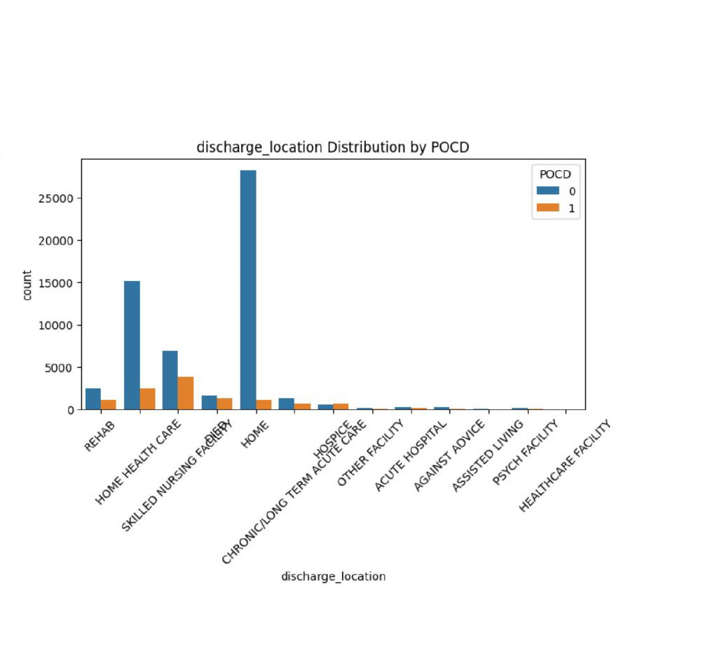
We examined how POCD is related to the type of discharge patients receive after surgery, such as going home independently, with home care, or to a rehabilitation center.
We observed that patients who needed more support after surgery (rehab, skilled nursing facilities, or home-care services) showed a higher number of POCD cases.
This indicates that a patient’s functional recovery and support needs after surgery may be strongly linked to their risk of developing POCD.

Slide 10
Model Development
We trained and compared multiple machine learning models, including Logistic Regression, Random Forest, and a Neural Network (MLP), to understand which performs best for POCD prediction.
All models were trained using stratified resampling to preserve the same POCD proportion in each split.
We tested the models on unseen data to measure how well they can predict POCD for new patients in real clinical situations.

Slide 11
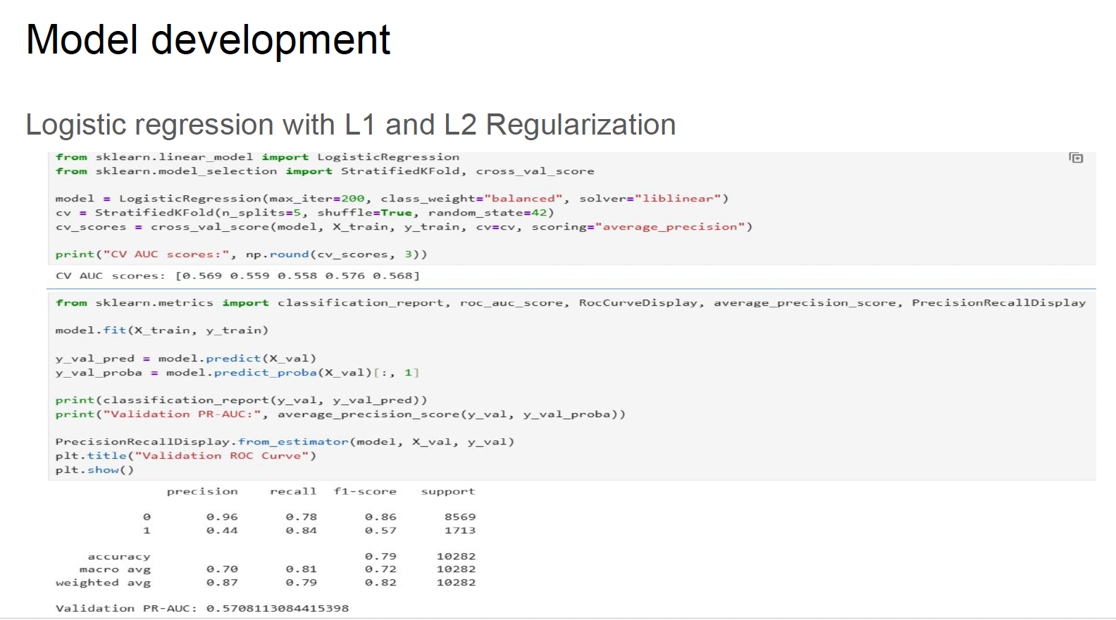
Logistic Regression
We first developed a Logistic Regression model because it is simple, fast, and easy to interpret in clinical settings.
We used both L1 and L2 regularization to avoid overfitting and to understand which features are truly important.
We trained the model on the balanced training set and evaluated it on unseen data.
The validation PR-AUC was around 0.57, showing a reasonable baseline for comparison.

Slide 12
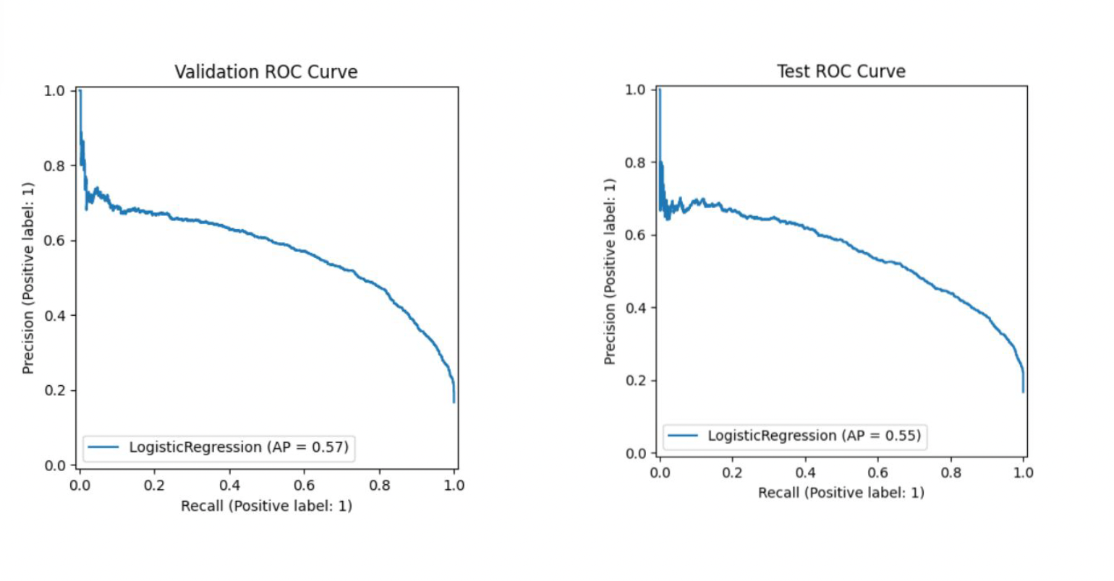
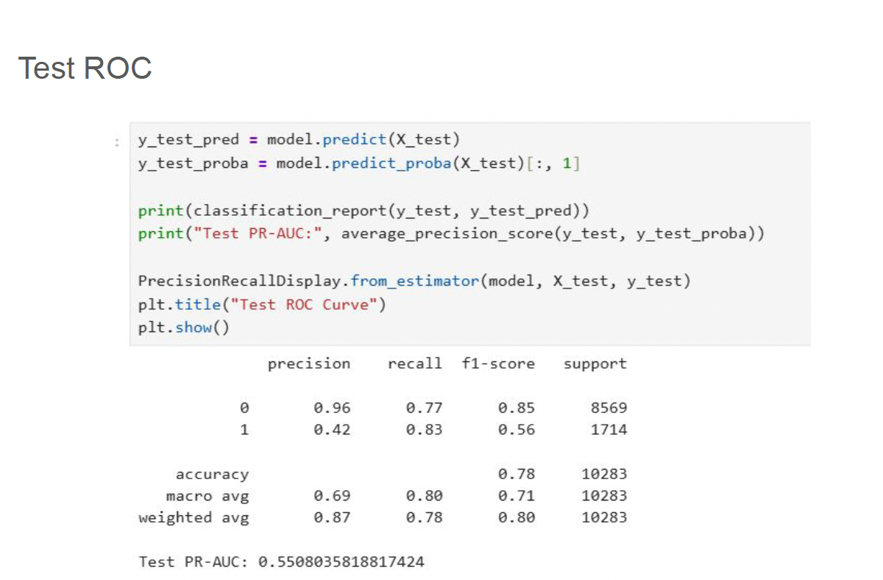
We evaluated the model using Precision-Recall metrics. The model correctly identified many non-POCD cases,but recall for POCD cases was still limited due to the complexity of this clinical outcome.
We applied GridSearchCV to find the best penalty, regularization strength, and solver. After tuning, the model improved slightly and became more stable.

Slide 13
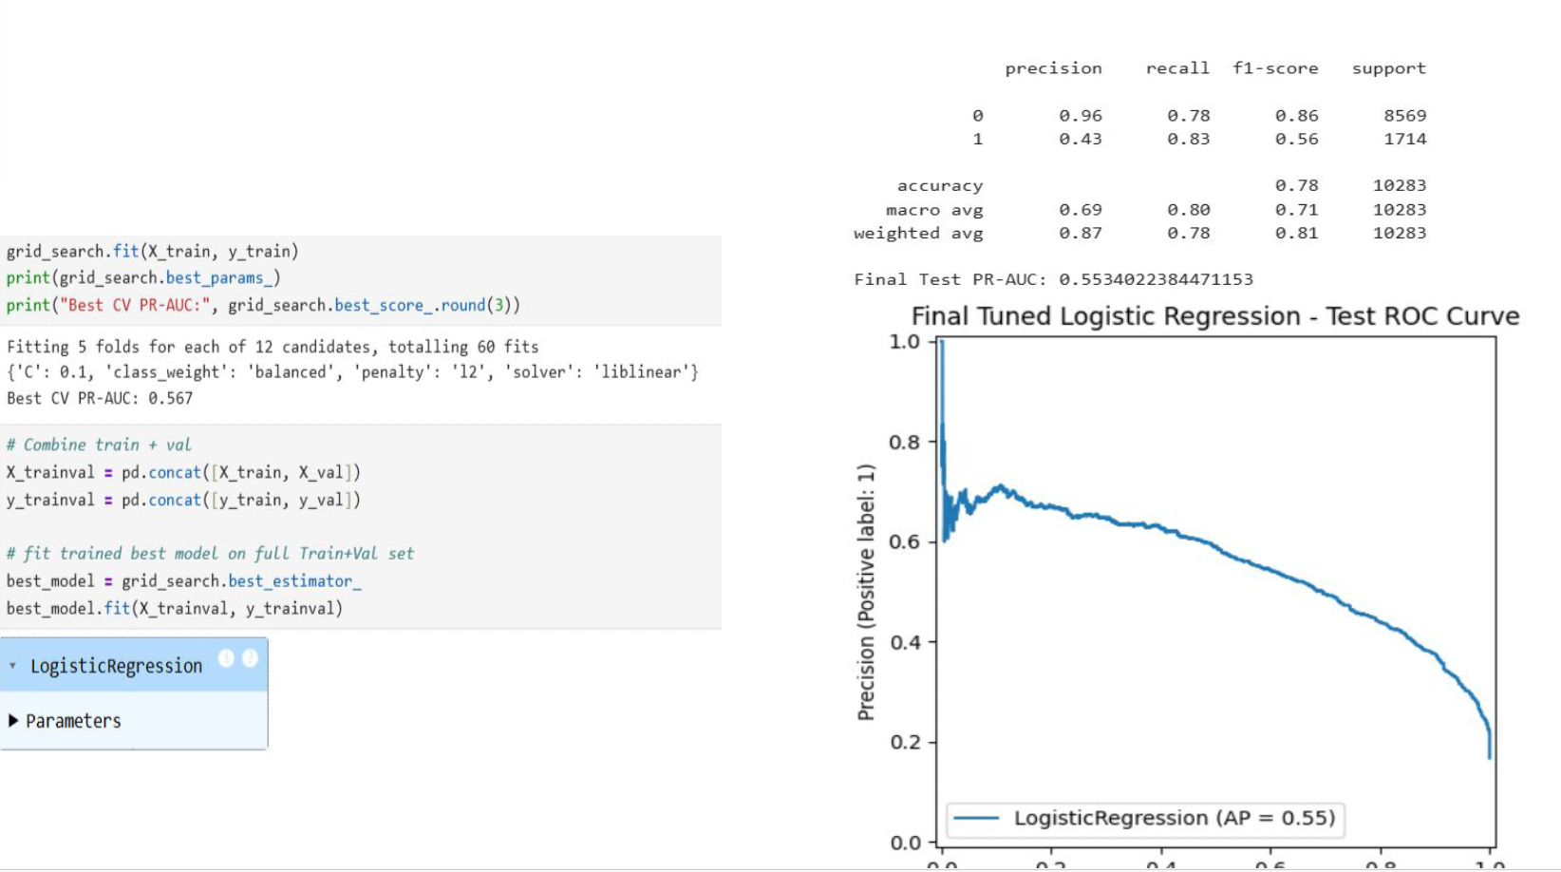

Slide 14
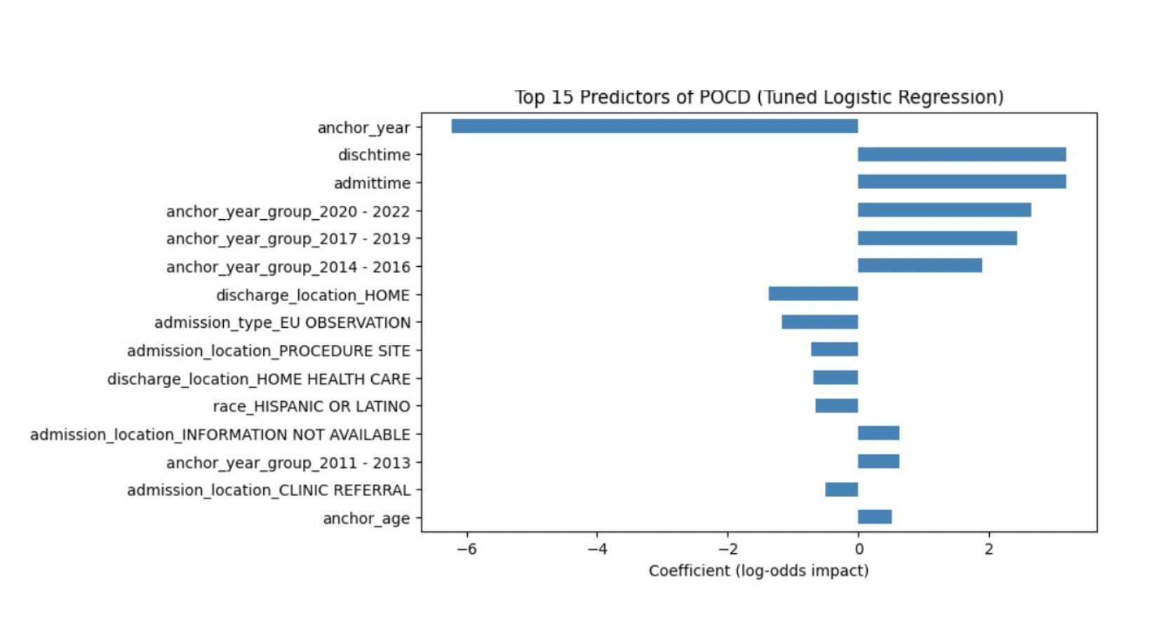
Important Predictors of POCD
Logistic Regression helps us understand which clinical features contribute the most to POCD risk, making the results easier for doctors to interpret.
Some of the strongest predictors included longer ICU stay, older age, and discharge to home-care or rehabilitation, which indicate patients who may need more support after surgery.
These findings agree with real-world medical knowledge, supporting the reliability of our model and showing that it learns clinically meaningful patterns.

Slide 15
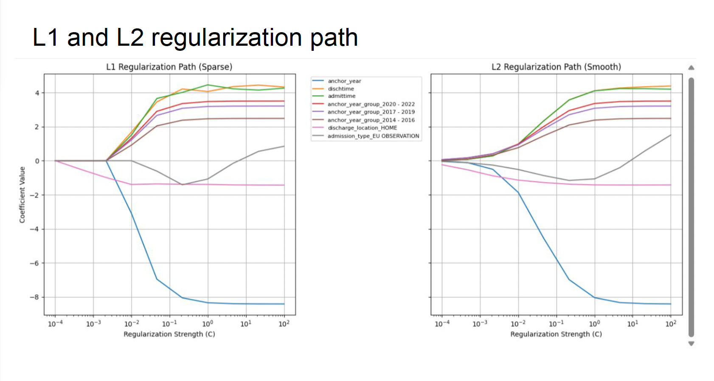
We compared L1 (sparse) vs L2 (smooth) regularization paths to observe feature selection behavior.

Slide 16
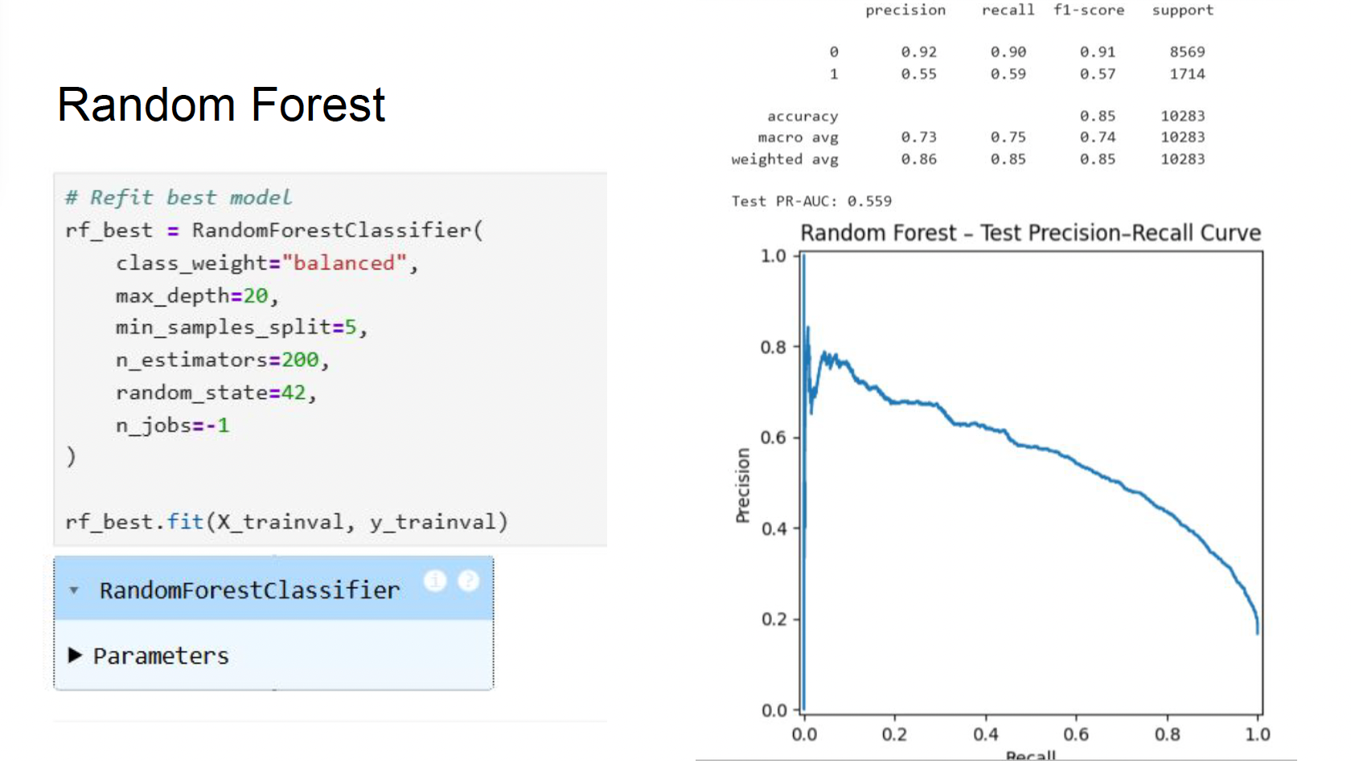
Random Forest Model
Then, We used Random Forest because it can capture complex non-linear patterns in ICU data that Logistic Regression may miss.
We trained the model using stratified resampling, so the POCD class proportion remains consistent in each train-test split.
We tuned key hyperparameters:
Number of trees
Tree depth Minimum samples per split
This model showed better recall for
POCD cases.

Slide 17
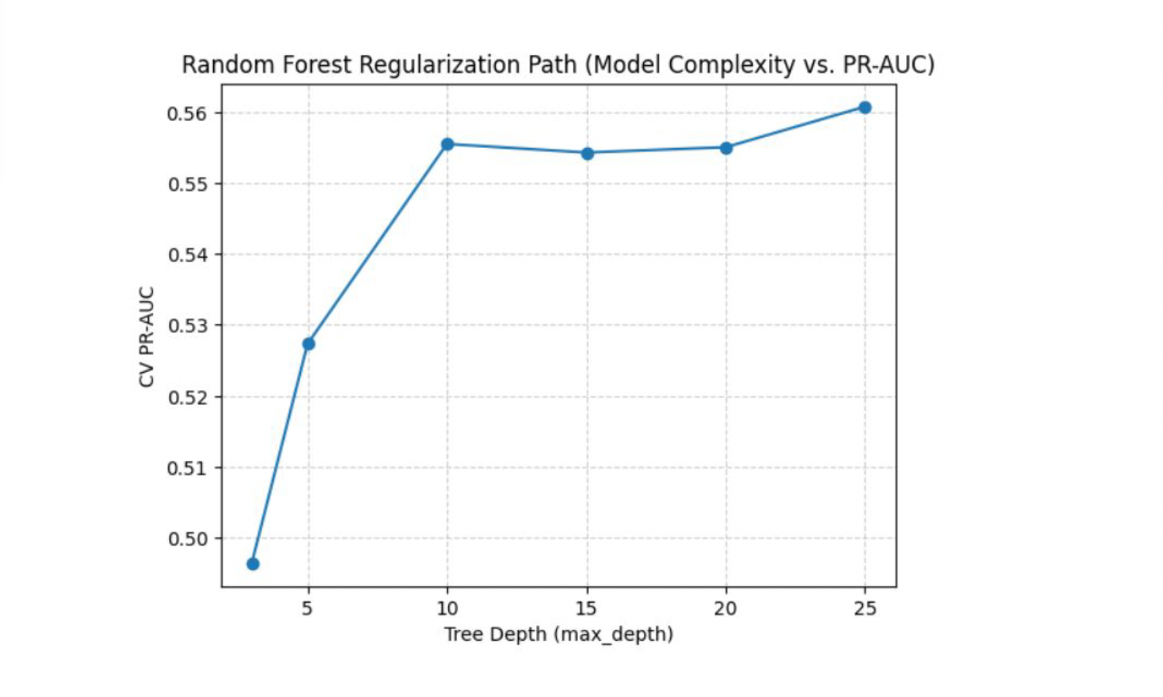
We tested different tree depths to find the best trade-off between accuracy and overfitting.

Slide 18
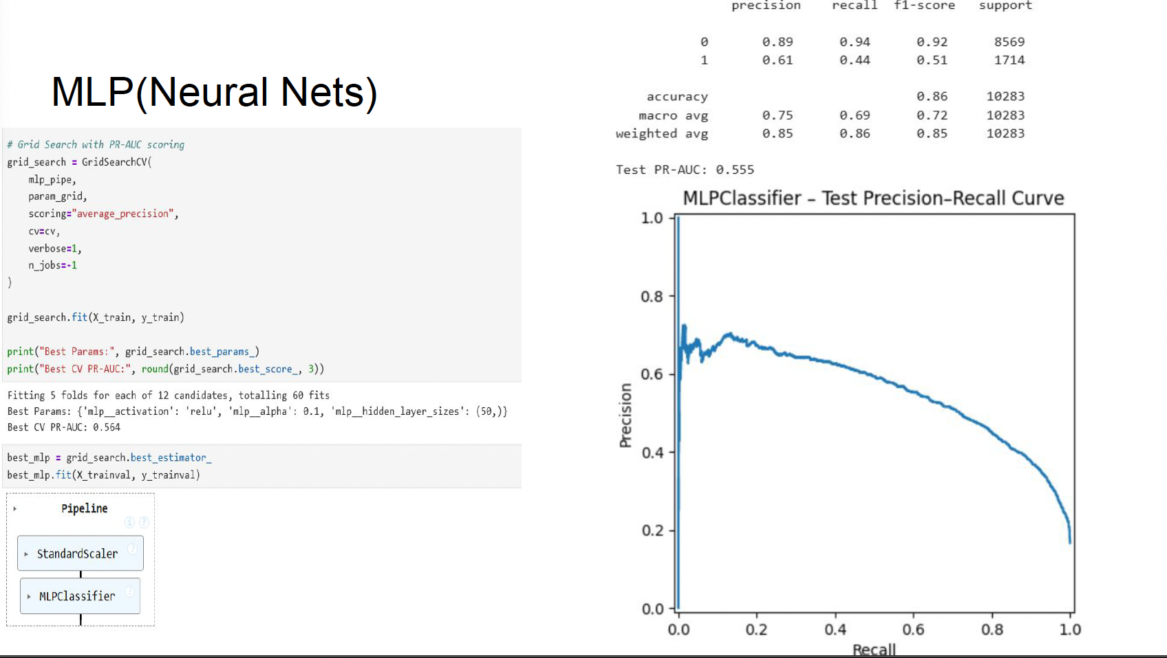
Neural Network (MLP) Model
We used an MLP classifier to learn hidden relationships between features. We applied GridSearchCV to find the best number of neurons and activation function.
This model achieved a PR-AUC similar to the Random Forest and showed that learning deeper patterns helps improve detection of minority cases.

Slide 19

Our models successfully detected POCD risk.
Random Forest and MLP performed slightly stronger than Logistic Regression
Key risk predictors such as:
Longer ICU stay
Need for discharge support
Older patient age align well with known clinical risk patterns
Results show that machine learning can support earlier POCD screening and better post-surgery care planning

Slide 20
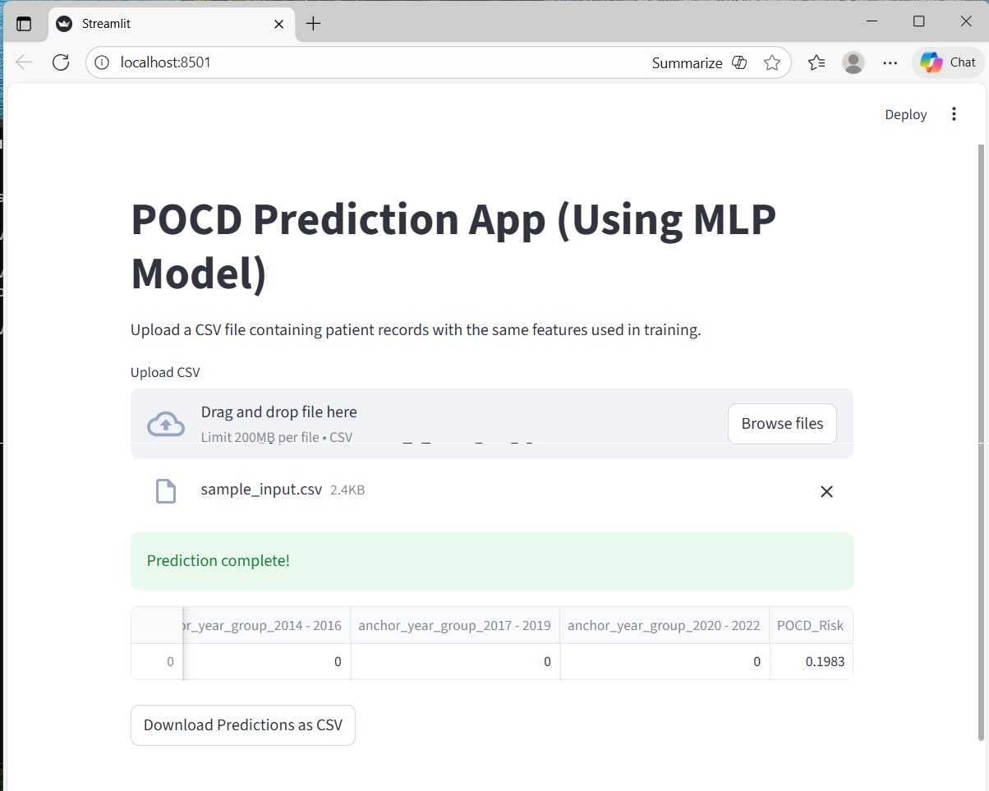

Slide 21

Clinical Impact & Conclusion
Helps doctors identify memory changes early instead of waiting for symptoms
Early support may reduce long-term cognitive disability after surgery
Better recovery and higher quality of life for elderly surgical patients
Can lower healthcare costs by preventing complications
Overall, machine learning can become a helpful screening tool to improve patient safety and post-operative care

Slide 22
Challenges & Limitations
Very few POCD cases in data → models struggle to learn rare events well
Dataset only has structured hospital data → no surgeon notes or cognitive test information
POCD diagnosis in records may not always be complete or consistent
Results are from one hospital dataset, so model must be tested in real hospitals before use

Slide 23
Future Scope
Including clinical notes from MIMIC-IV Notes can provide richer understanding of symptoms and cognitive condition
More advanced machine learning models (e.g., XGBoost, LightGBM) may improve prediction performance
Adding anesthesia-related factors, medications, and comorbid conditions can help capture additional clinical risks
A doctor-friendly dashboard could be developed for easy POCD risk assessment in hospitals
Collaboration with clinicians can help validate the model in real practice and increase trust in predictions

Slide 24
References
Johnson, A. E. W., Bulgarelli, L., Shen, L., et al. (2023). MIMIC-IV, a freely accessible electronic health record dataset. Scientific Data, 10(1), 1. https://doi.org/10.1038/s41597-022-01899-x
Zhao, Q., Wan, H., Pan, H., & Xu, Y. (2024). Postoperative cognitive dysfunction—current research progress. Frontiers in Behavioral Neuroscience, 18, 1328790. https://doi.org/10.3389/fnbeh.2024.1328790
Arefayne, N. R., Berhe, Y. W., & van Zundert, A. A. (2023). Incidence and factors related to prolonged postoperative cognitive decline in elderly patients following surgery and anaesthesia: A systematic review. Journal of Multidisciplinary Healthcare, 16, 3405–3413. https://doi.org/10.2147/JMDH.S431168
Kotekar, N., Kuruvilla, C. S., & Murthy, V. (2014). Post-operative cognitive dysfunction in the elderly: A prospective clinical study. Indian Journal of Anaesthesia, 58(3), 263–268. https://doi.org/10.4103/0019-5049.135034
Evered, L. A., & Silbert, B. S. (2018). Postoperative cognitive dysfunction and noncardiac surgery. Anesthesia & Analgesia, 127(2), 496–505. https://doi.org/10.1213/ANE.0000000000003514
Borchers, F., Spies, C. D., Feinkohl, I., et al. (2021). Methodology of measuring postoperative cognitive dysfunction: A systematic review. British Journal of Anaesthesia, 126(6), 1119–1127. https://doi.org/10.1016/j.bja.2021.01.035
Anand, N., Gupta, R., Mishra, S. P., & Mishra, M. (2024). Postoperative cognitive dysfunction: A review. Asian Journal of Anesthesiology, 62(1), 1–11. https://doi.org/10.6859/aja.202403_62(1).0001
Wu, Y., Yu, C., & Gao, F. (2023). Risk factors for postoperative cognitive dysfunction in elderly patients undergoing surgery for oral malignancies. Perioperative Medicine, 12(42), 1–9. https://doi.org/10.1186/s13741-023-00330-2
Sun, J., Du, X., & Chen, Y. (2024). Current progress on postoperative cognitive dysfunction: An update. Journal of Integrative Neuroscience, 23(12), 224. https://doi.org/10.31083/j.jin2312224

Slide 25

Thank you

